Slide 2
Topics
Designing a Program
Input, Processing, and Output
Displaying Output with print Function
Comments
Variables
Reading Input from the Keyboard
Performing Calculations
More About Data Output

Slide 3
Designing a Program
Programs must be designed before they are written
Program development cycle:
  Design the program
  Write the code
  Correct syntax errors
  Test the program
  Correct logic errors

Slide 4
Designing a Program (cont’d.)
Design is the most important part of the program development cycle
Understand the task that the program is to perform
  Work with customer to get a sense what the program is supposed to do
  Ask questions about program details
  Create one or more software requirements

Slide 5
Designing a Program (cont’d.)
Determine the steps that must be taken to perform the task
  Break down required task into a series of steps
  Create an algorithm, listing logical steps that must be taken
Algorithm: set of well-defined logical steps that must be taken to perform a task

Slide 6
Pseudocode
Pseudocode: fake code
  Informal language that has no syntax rule
  Not meant to be compiled or executed
  Used to create model program
    No need to worry about syntax errors, can focus on program’s design
    Can be translated directly into actual code in any programming language

Slide 7
Flowcharts
Flowchart: diagram that graphically depicts the steps in a program
  Ovals are terminal symbols
  Parallelograms are input and output symbols
  Rectangles are processing symbols
  Symbols are connected by arrows that represent the flow of the program

Slide 8
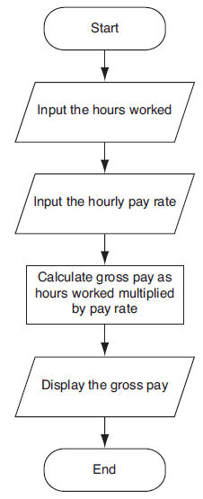

Slide 9
Input, Processing, and Output
Typically, computer performs three-step process
  Receive input
    Input: any data that the program receives while it is running
  Perform some process on the input
    Example: mathematical calculation
  Produce output

Slide 10
Displaying Output with the print Function
Function: piece of prewritten code that performs an operation
print function: displays output on the screen
Argument: data given to a function
  Example: data that is printed to screen
Statements in a program execute in the order that they appear
  From top to bottom

Slide 11
Strings and String Literals
String: sequence of characters that is used as data
String literal: string that appears in actual code of a program
  Must be enclosed in single (‘) or double (“) quote marks
  String literal can be enclosed in triple quotes (''' or """)
    Enclosed string can contain both single and double quotes and can have multiple lines

Slide 12
Comments
Comments: notes of explanation within a program
  Ignored by Python interpreter
    Intended for a person reading the program’s code
  Begin with a # character
End-line comment: appears at the end of a line of code
  Typically explains the purpose of that line

Slide 13
Variables
Variable: name that represents a value stored in the computer memory
  Used to access and manipulate data stored in memory
  A variable references the value it represents
Assignment statement: used to create a variable and make it reference data
  General format is variable = expression
    Example: age = 29
    Assignment operator: the equal sign (=)

Slide 14
Variables (cont’d.)
In assignment statement, variable receiving value must be on left side
A variable can be passed as an argument to a function
  Variable name should not be enclosed in quote marks
You can only use a variable if a value is assigned to it

Slide 15
Variable Naming Rules
Rules for naming variables in Python:
  Variable name cannot be a Python key word
  Variable name cannot contain spaces
  First character must be a letter or an underscore
  After first character may use letters, digits, or underscores
  Variable names are case sensitive
Variable name should reflect its use

Slide 16
Displaying Multiple Items with the print Function
Python allows one to display multiple items with a single call to print
  Items are separated by commas when passed as arguments
  Arguments displayed in the order they are passed to the function
  Items are automatically separated by a space when displayed on screen

Slide 17
Variable Reassignment
Variables can reference different values while program is running
Garbage collection: removal of values that are no longer referenced by variables
  Carried out by Python interpreter
A variable can refer to item of any type
  Variable that has been assigned to one type can be reassigned to another type

Slide 18
Numeric Data Types, Literals, and the str Data Type
Data types: categorize value in memory
  e.g., int for integer, float for real number, str used for storing strings in memory
Numeric literal: number written in a program
  No decimal point considered int, otherwise, considered float
Some operations behave differently depending on data type

Slide 19
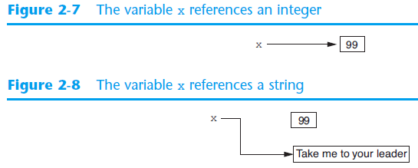
Reassigning a Variable to a Different Type
A variable in Python can refer to items of any type

Slide 20
Reading Input from the Keyboard
Most programs need to read input from the user
Built-in input function reads input from keyboard
  Returns the data as a string
  Format: variable = input(prompt)
    prompt is typically a string instructing user to enter a value
  Does not automatically display a space after the prompt

Slide 21
Reading Numbers with the input Function
input function always returns a string
Built-in functions convert between data types
  int(item) converts item to an int
  float(item) converts item to a float
  Nested function call: general format: function1(function2(argument))
    value returned by function2 is passed to function1
  Type conversion only works if item is valid numeric value, otherwise, throws exception

Slide 22
Performing Calculations
Math expression: performs calculation and gives a value
  Math operator: tool for performing calculation
  Operands: values surrounding operator
    Variables can be used as operands
  Resulting value typically assigned to variable
Two types of division:
  / operator performs floating point division
  // operator performs integer division
    Positive results truncated, negative rounded away from zero

Slide 23
Operator Precedence and Grouping with Parentheses
Python operator precedence:
  Operations enclosed in parentheses
    Forces operations to be performed before others
  Exponentiation (**)
  Multiplication (*), division (/ and //), and remainder (%)
  Addition (+) and subtraction (-)
Higher precedence performed first
  Same precedence operators execute from left to right

Slide 24
The Exponent Operator and the Remainder Operator
Exponent operator (**): Raises a number to a power
  x ** y = x^{y}
Remainder operator (%): Performs division and returns the remainder
  a.k.a. modulus operator
  e.g., 4%2=0, 5%2=1
  Typically used to convert times and distances, and to detect odd or even numbers

Slide 25
Converting Math Formulas to Programming Statements
Operator required for any mathematical operation
When converting mathematical expression to programming statement:
  May need to add multiplication operators
  May need to insert parentheses

Slide 26
Mixed-Type Expressions and Data Type Conversion
Data type resulting from math operation depends on data types of operands
  Two int values: result is an int
  Two float values: result is a float
  int and float: int temporarily converted to float, result of the operation is a float
    Mixed-type expression
  Type conversion of float to int causes truncation of fractional part

Slide 27
Breaking Long Statements into Multiple Lines
Long statements cannot be viewed on screen without scrolling and cannot be printed without cutting off
Multiline continuation character (\): Allows to break a statement into multiple lines
  Example:
    print(‘my first name is’,\ first_name)

Slide 28
More About Data Output
print function displays line of output
  Newline character at end of printed data
  Special argument end=‘delimiter’ causes print to place delimiter at end of data instead of newline character
print function uses space as item separator
  Special argument sep=‘delimiter’ causes print to use delimiter as item separator

Slide 29
More About Data Output (cont’d.)
Special characters appearing in string literal
  Preceded by backslash (\)
    Examples: newline (\n), horizontal tab (\t)
  Treated as commands embedded in string
When + operator used on two strings in performs string concatenation
  Useful for breaking up a long string literal

Slide 30
Formatting Numbers
Can format display of numbers on screen using built-in format function
  Two arguments:
    Numeric value to be formatted
    Format specifier
  Returns string containing formatted number
  Format specifier typically includes precision and data type
    Can be used to indicate scientific notation, comma separators, and the minimum field width used to display the value

Slide 31
Formatting Numbers (cont’d.)
The % symbol can be used in the format string of format function to format number as percentage
To format an integer using format function:
  Use d as the type designator
  Do not specify precision
  Can still use format function to set field width or comma separator

Slide 32
Summary
This chapter covered:
  The program development cycle, tools for program design, and the design process
  Ways in which programs can receive input, particularly from the keyboard
  Ways in which programs can present and format output
  Use of comments in programs
  Uses of variables
  Tools for performing calculations in programs

